Slide 1
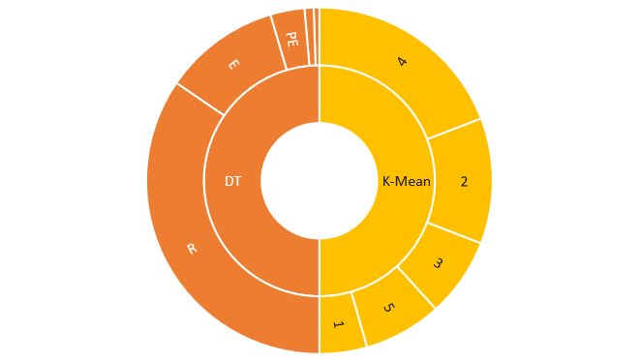
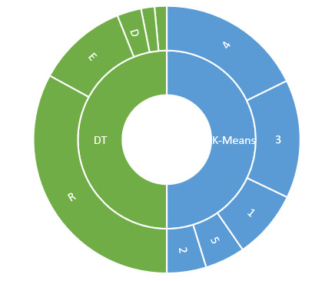
D
LM
LM
PE

Slide 2
26748
Reconnaissance:
657
Delivery:
Decision Tree Results
2472
Privilege Escalation:
414
Lateral Movement:
Before implementing retrospective chronology
8421
Exfiltration:
3444
Cluster 1:
9088
k-means clustering results
Cluster 2:
5722
Cluster 3:
14816
Cluster 4:
5642
Cluster 5:
25499
Reconnaissance:
2277
Decision Tree Results
Delivery:
1262
Privilege Escalation:
1149
Lateral Movement:
8525
After implementing retrospective chronology
Exfiltration:
6422
Cluster 1:
3704
k-means clustering results
Cluster 2:
11097
Cluster 3:
13741
Cluster 4:
3748
Cluster 5:

